Slide 1



SentinelAI
Enterprise Fraud Defense Platform
CMPE 256
Siddharth Rao Kartik
Vineeth Chandra Sai Kandukuri
Pranjal Shrivastava

Slide 2







The Challenge: Why Traditional Systems Fail
Severe Imbalance
"Black Box" Trust
Static Rules
Genuine fraud represents <0.2% of transactions. Standard models ignore this minority class entirely.
Complex models make accurate predictions but offer no explanation, leading to regulatory compliance failures.
Rules-based systems (e.g., "if > $10k") are too slow to catch zero-day attacks and evolving fraud rings.

Slide 3




Introducing SentinelAI
A production-grade Recommender Engine that doesn't just detect fraud—it prioritizes risk, explains decisions, and adapts in real-time.

Slide 4

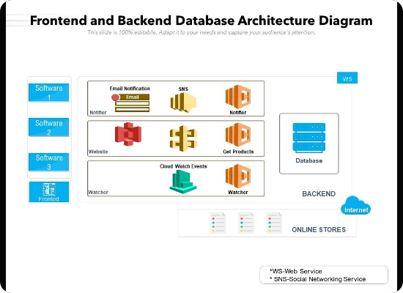
Microservices Architecture
Decoupled for Scalability
•
Frontend (The Face): Built with Streamlit for interactive analyst dashboards and real-time visualization.
•
Backend (The Brain): A high-performance FastAPI server handling inference and logic.
•
Persistence Layer: SQLite database for immutable audit logging and model drift monitoring.
"Not just a script, but a deployed system."

Slide 5

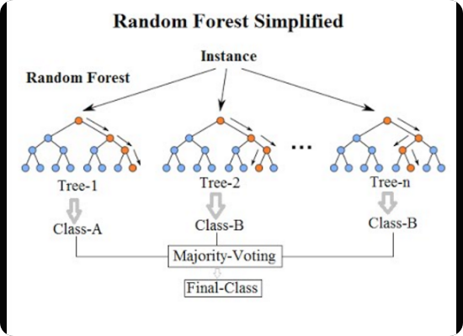
The "Brain": Hybrid Ensemble Engine
Best of Both Worlds
1. Supervised: Random Forest
Trained on historical data to catch known fraud patterns with high precision.
2. Unsupervised: Isolation Forest
Detects statistical anomalies and outliers to catch Zero-Day attacks.
3. SMOTE Pipeline
Mathematically rebalances the dataset to prevent model bias toward the majority class.

Slide 6
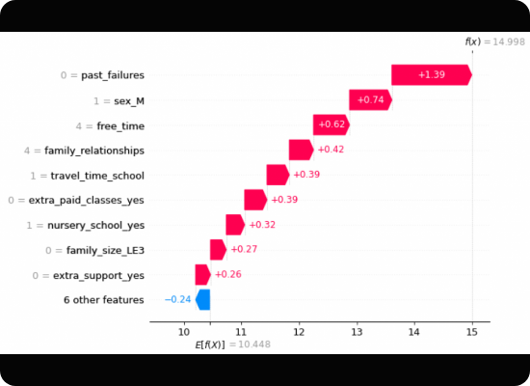
Explainable AI (XAI) with SHAP
Solving the "Black Box" Problem
We don't just output a risk score; we tell the analyst why.
•
Uses Game Theory (Shapley Values) to calculate marginal feature contribution.
•
Red Bars: Push risk HIGHER (e.g., High Amount, Foreign IP).
•
Blue Bars: Push risk LOWER (e.g., Trusted Device).

Slide 7
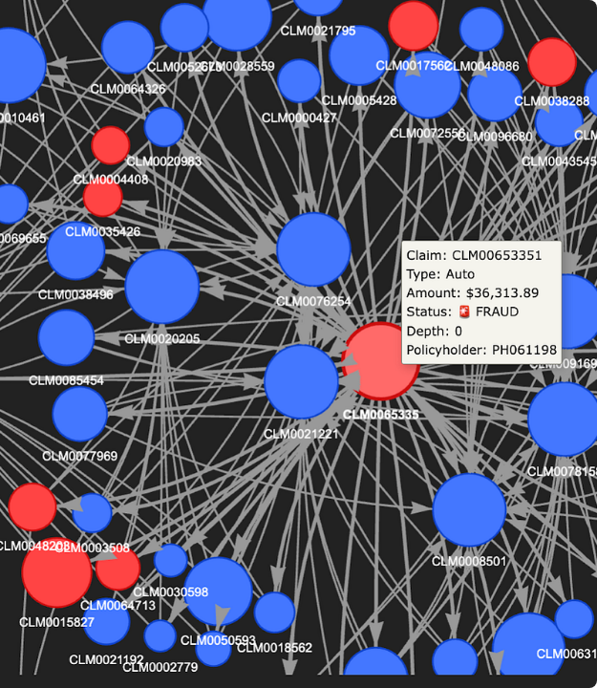
Advanced Link Analysis
Detecting Organized Fraud Rings
Sophisticated attackers use different accounts but often share underlying attributes.
Our Graph Theory Module visualizes these hidden connections:
•
Shared IP Addresses
•
Common Device IDs
•
Collusion between accounts
This catches fraud that individual transaction analysis misses.

Slide 8
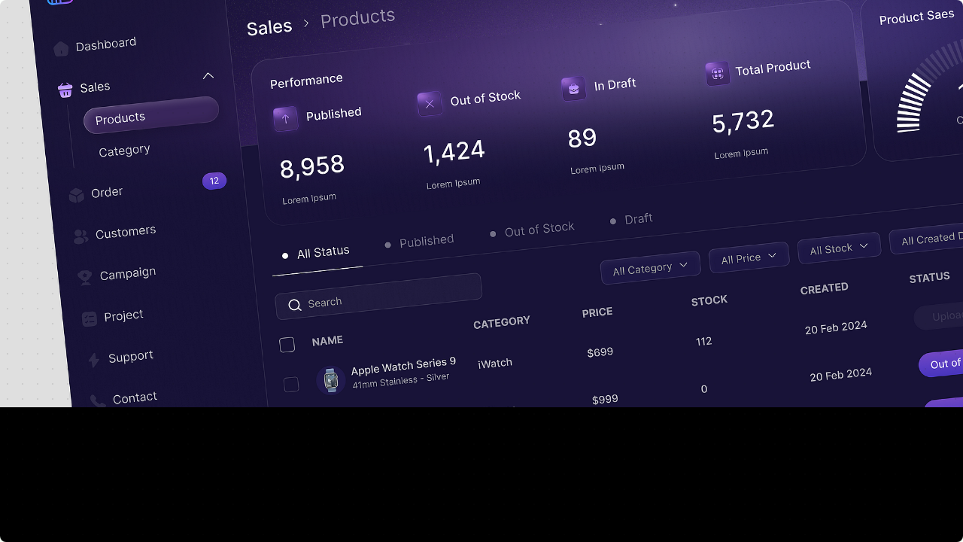


Live Demo
Showcasing SentinelAI in Action
1. Real-time Ingestion • 2. Risk Scoring • 3. Graph Analysis

Slide 9
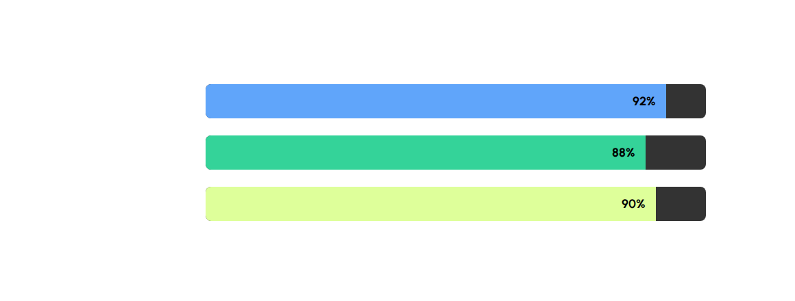
Model Performance
Evaluated on Test Set (20% Split) with Imbalanced Data
High F1-Score proves robustness against class imbalance.

Slide 10



Future Scope & Deployment
Containerization
Real-Time Streams
Deep Learning
Deploy backend and frontend services via Docker/Kubernetes for cloud scaling.
Replace REST batching with Apache Kafka for sub-millisecond transaction ingestion.
Implement Autoencoders and GNNs (Graph Neural Networks) for complex pattern recognition.

Slide 11

Questions?
Thank you for your attention.
SentinelAI Team

Slide 12






Image Sources
https://www.slideteam.net/media/catalog/product/cache/1280x720/f/r/frontend_and_backend_database_architecture_diagram_slide01.jpg
Source: www.slideteam.net
https://miro.medium.com/0*JDdCH7D_SAuAF8gy.png
Source: medium.com
https://www.justintodata.com/wp-content/uploads/2022/02/shap-waterfall-instance-2-1024x623.png
Source: www.justintodata.com
https://miro.medium.com/v2/resize:fit:1200/1*PAjJkQirOVwaVAoxY3vlVw.png
Source: medium.com
https://static.vecteezy.com/system/resources/previews/026/384/935/non_2x/futuristic-glowing-padlock-with-plexus-lines-and-glitter-particles-a-padlock-in-the-neon-light-style-cyber-security-data-and-privacy-protection-digital-technology-background-vector.jpg
Source: www.vecteezy.com
https://miro.medium.com/v2/resize:fit:2000/1*XC0xECuKKGLSRTr9f9MFIQ.png
Source: medium.com

